Slide 1
Personalized Healthcare Recommendation system for ICU Patients
TEAM D:
SHRI AISWARYA GORLE
SHASHANK RAJ GUPTA GUNTA
VENKATA NAGA SHARANYA KHANDE RAO

Slide 2
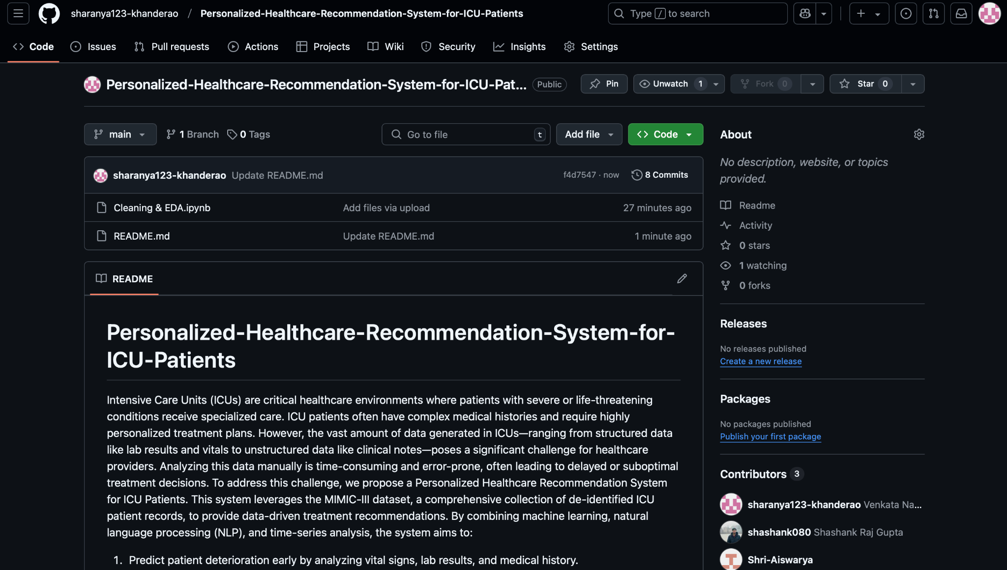
GITHUB REPO
https://github.com/sharanya123-khanderao/Personalized-Healthcare-Recommendation-System-for-ICU-Patients
Kaggle ID : khanderaosharanya

Slide 3
WHY THIS PROJECT ?
•Life-Saving Impact: Early detection of patient deterioration enables prompt, potentially life-saving interventions.
•Efficient Resource Allocation: Risk stratification (low, medium, high) prioritizes ICU care and optimizes resource use.
•Multimodal Data Integration: Combines structured data (vitals, labs, history) with unstructured clinical notes for a comprehensive view.
•Innovative Techniques: Leverages advanced ML & NLP to uncover hidden patterns and predict adverse events.
•Real-World Relevance: Uses the robust, publicly available MIMIC-III dataset to simulate realistic ICU scenarios.
•Explainable AI: Enhances clinical decision support through transparent, interpretable models.

Slide 4
SIMILAR APPROACHES
Existing ML models for ICU predictions:
•Mortality prediction using logistic regression, decision trees.
•ICU length-of-stay forecasting using time-series analysis.
•NLP for clinical notes using TF-IDF, LDA, transformers (BERT).
What’s Missing?
•Lack of real-time patient risk prediction.
•Minimal integration of multimodal data (structured + unstructured).
•Explainability and interpretability of AI-driven decisions.

Slide 5
LITERATURE REVIEW
Key Studies & Findings
MIMIC-IV Mortality Prediction (ZHAW) & MIMIC-III Analysis (Frontiers)
Utilized statistical models (correlation analysis, logistic regression) to predict ICU mortality.
Identified key risk factors influencing patient survival.
Combined machine learning techniques with clinical knowledge for decision-making.
Developed ICU mortality prediction models, specifically for thoracic fracture patients (MIMIC-III).
Limitations Limited deep learning integration for enhanced accuracy No NLP-based analysis of unstructured clinical notes. Scope restrictions (e.g., MIMIC-III study focused only on thoracic fractures). This combined analysis highlights the strengths and gaps in existing ICU mortality prediction models.

Slide 6
SUMMARY OF WHAT OTHERS HAVE DONE
Feature Selection Methods Used: PCA, RFE, LASSO.
ML Models Applied: Logistic Regression, SVM, Decision Trees.
Key Limitations in Past Studies:
Lack of explainability & real-time application.
Minimal NLP integration for clinical notes.
No multimodal patient data fusion.

Slide 7
OUR PROJECT
What are we doing?
Predict patient deterioration early by analyzing vital signs, lab results, and medical history.
⁠Classify patients into risk levels (low, medium, high) to prioritize critical cases and optimize resource allocation.
Extract insights from clinical notes using advanced NLP techniques to uncover hidden patterns and improve decision-making.
⁠Analyze longitudinal trends in patient data to detect potential complications before they become critical.
Improvement over previous studies:
Multimodal Data Integration
Advanced NLP Techniques
Real-Time Prediction & Alerts
Enhanced Mortality & Risk Stratification
Explainable AI for Decision Support

Slide 8
DATASET OVERVIEW
MIMIC-III Dataset
•ICU patient records from real-world hospitals.
•Structured Data: Vitals, lab results, medications, diagnoses.
•Unstructured Data: Clinical notes, discharge summaries.
•Kaggle Link: https://www.kaggle.com/datasets/asjad99/mimiciii/data
•Size: 100 MB
KEY STATISTICS
•Number of Instances/Samples: The dataset includes information on 46,520 unique patients, encompassing 58,976 hospital admissions.
•Number of Raw Attributes: Data is organized into 26 tables, comprising a total of 324 distinct attributes.
•Number of Features: The dataset contains 112,000 clinical reports, with each report averaging 709.3 tokens in length. These reports are annotated with 1,159 top-level ICD-9 codes, with each report assigned an average of 7.6 codes.

Slide 9
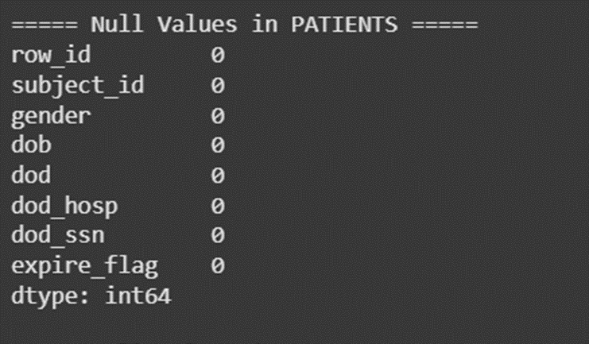
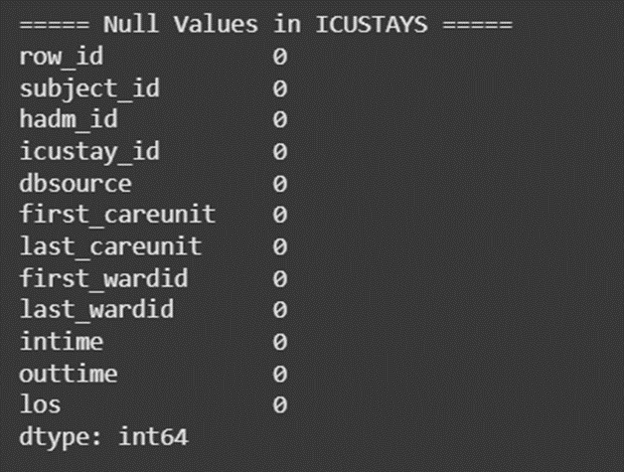
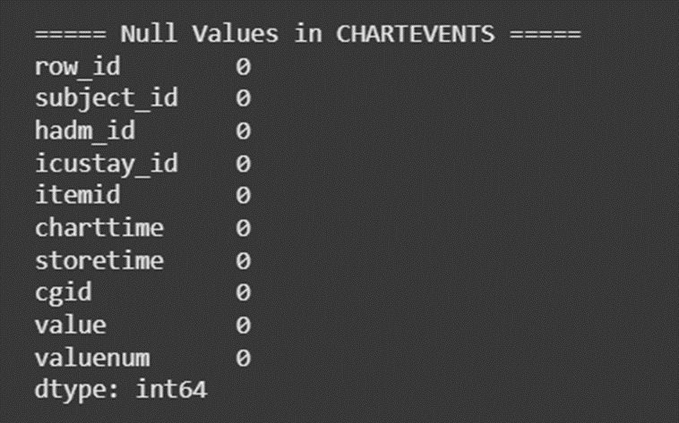
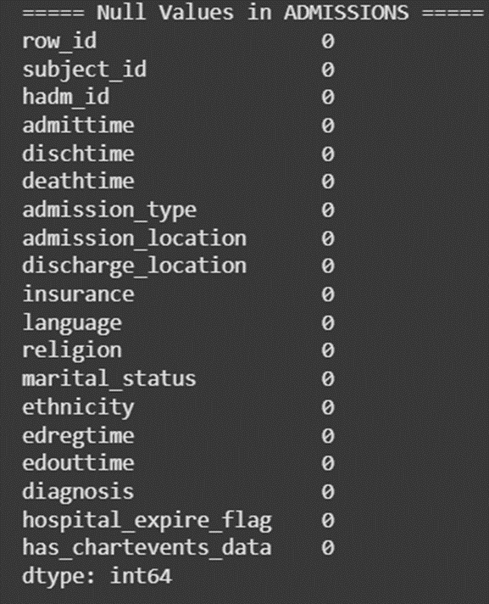
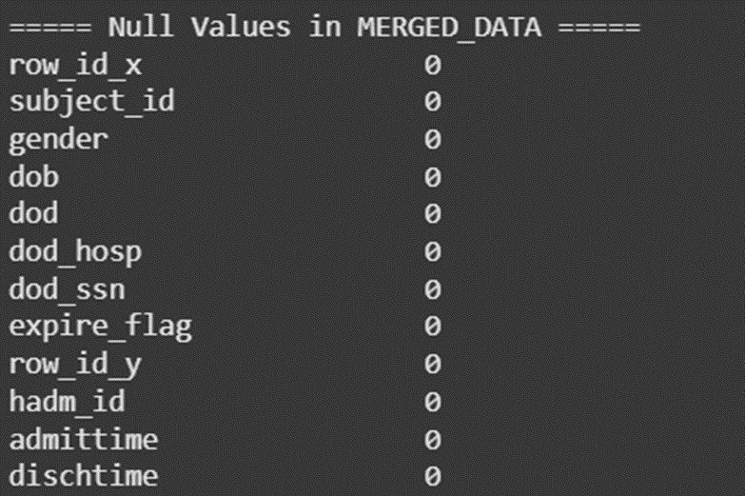
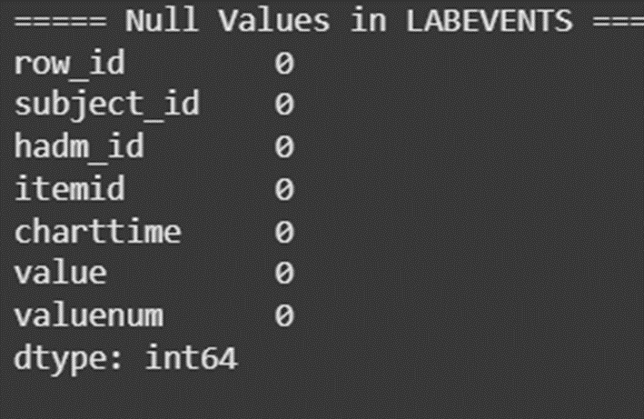
DATA CLEANING

Slide 10
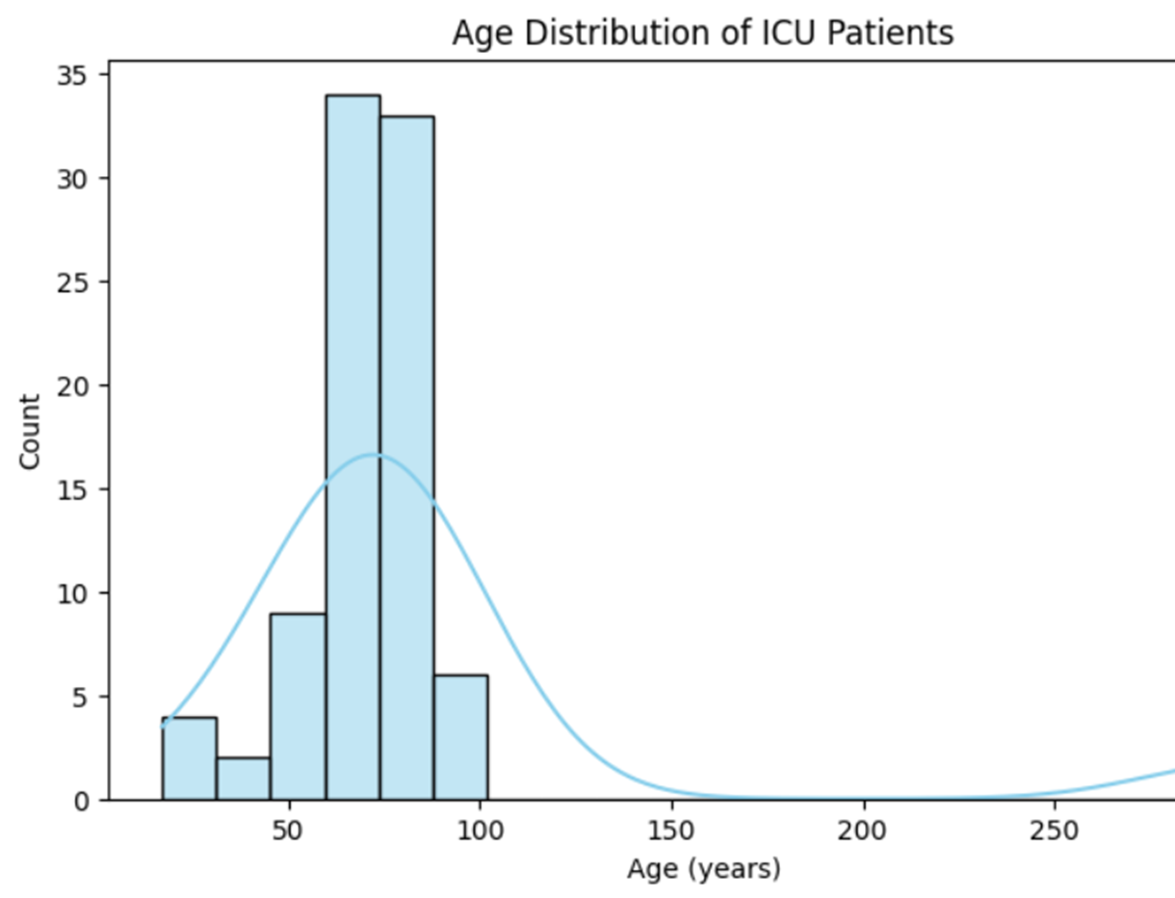
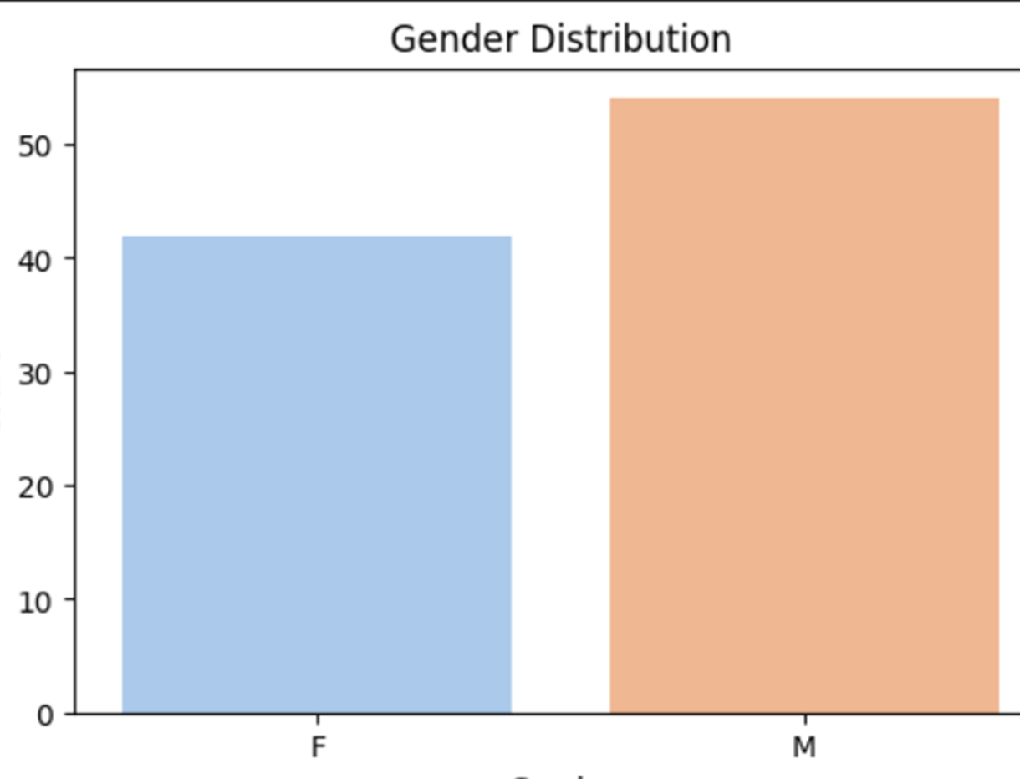
EDA
Demographic features can be used as baseline risk indicators and help in tailoring predictive models to account for age, gender, and racial differences in patient deterioration.

Slide 11
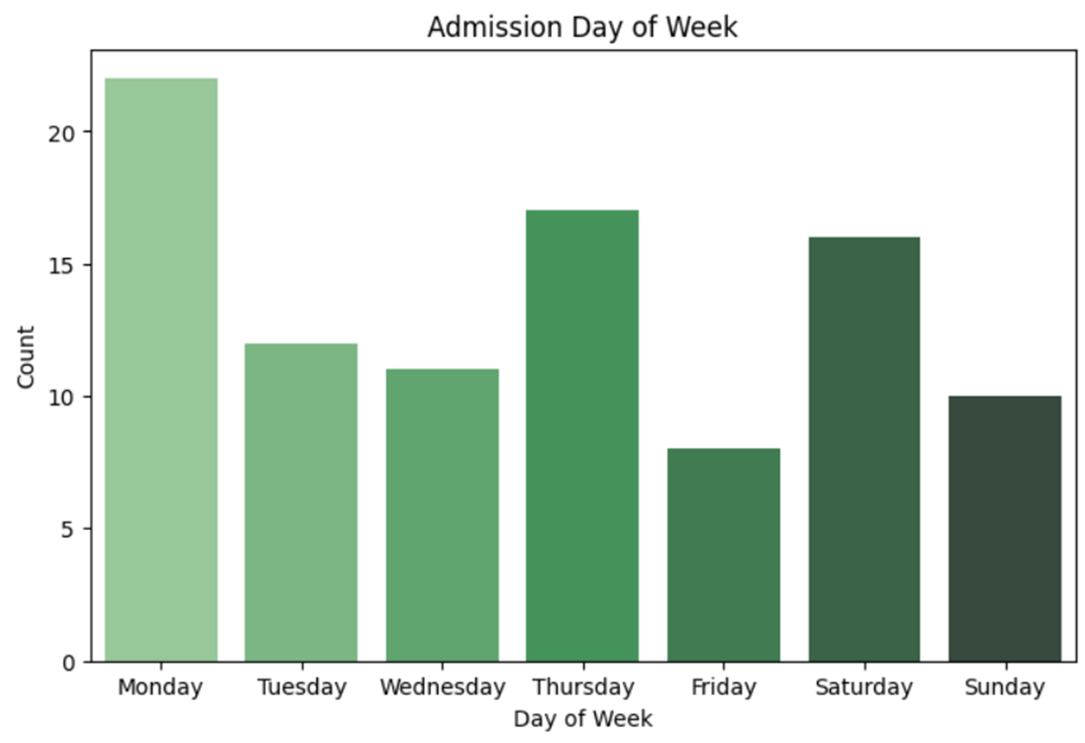
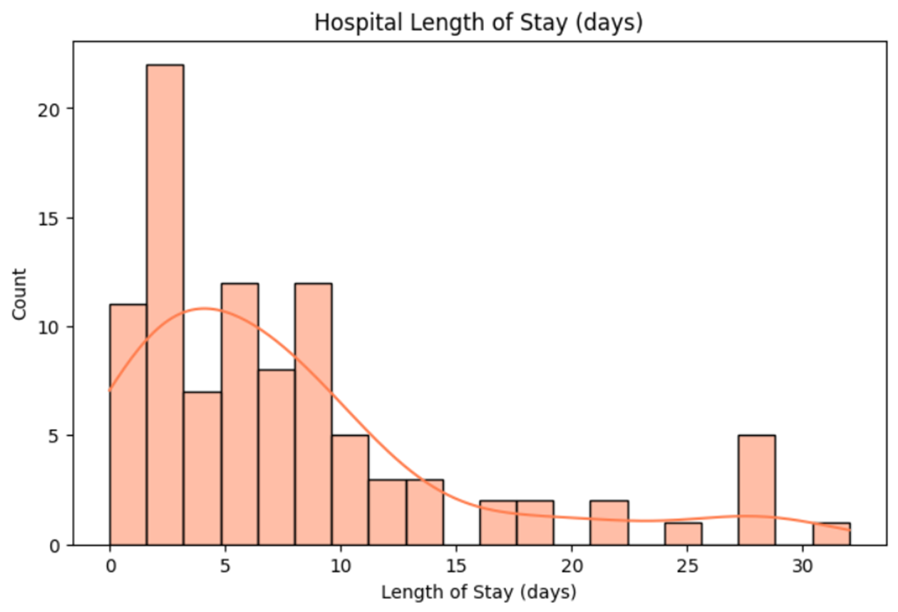
EDA
These insights are used to derive temporal features—like ICU stay duration—which can be integrated into our predictive models to forecast patient deterioration.

Slide 12
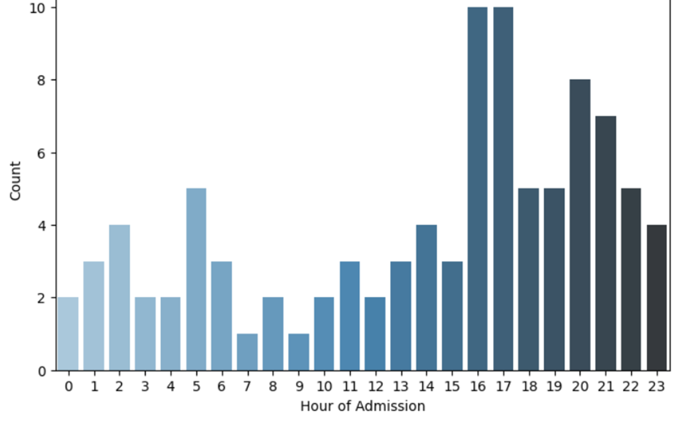
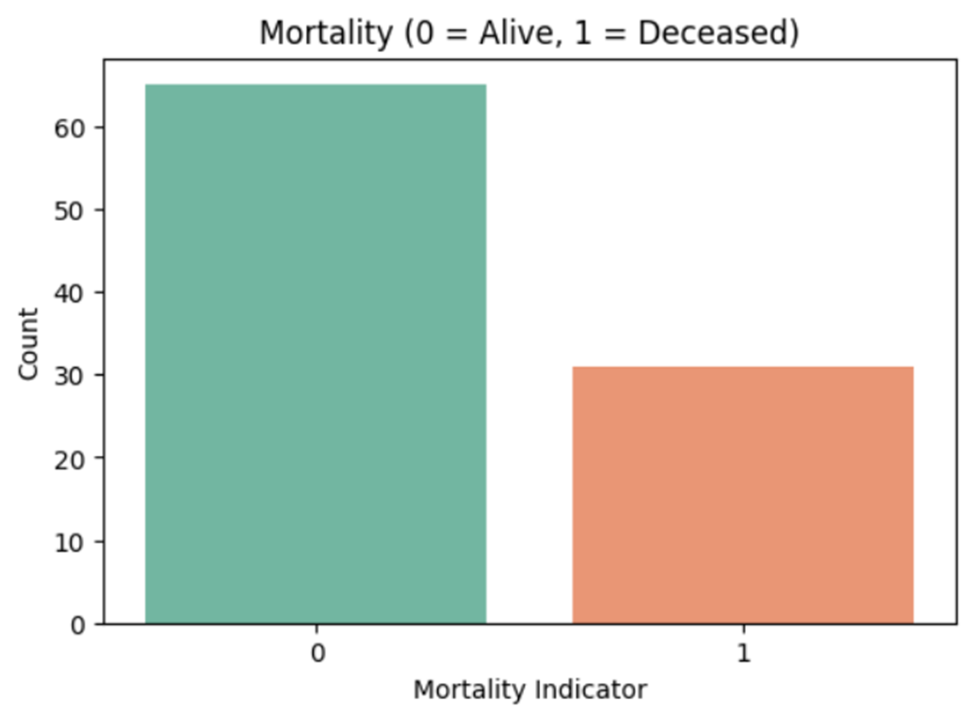
EDA

Slide 13
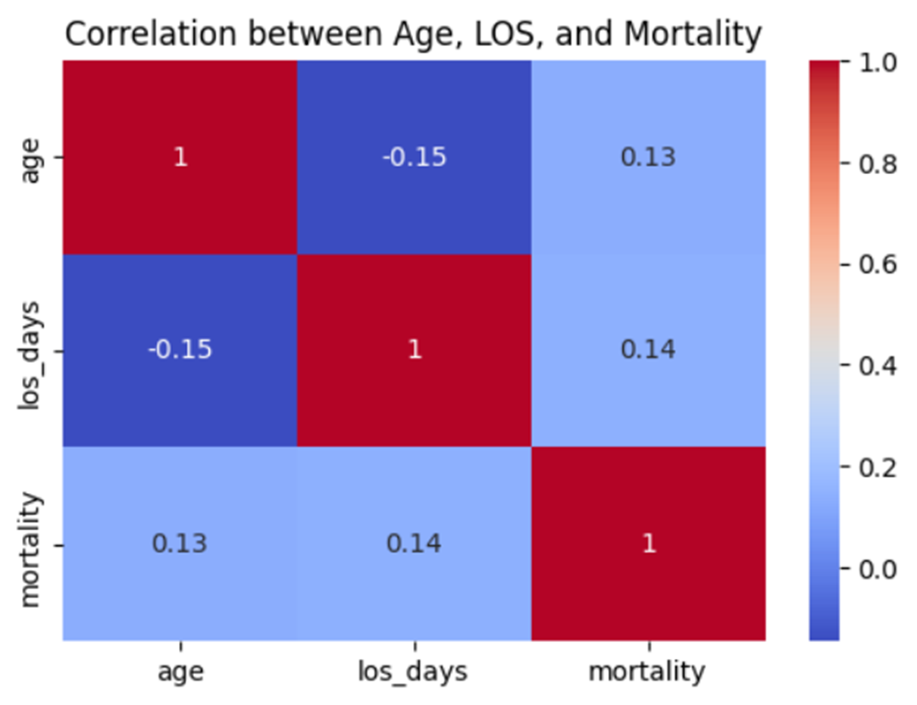
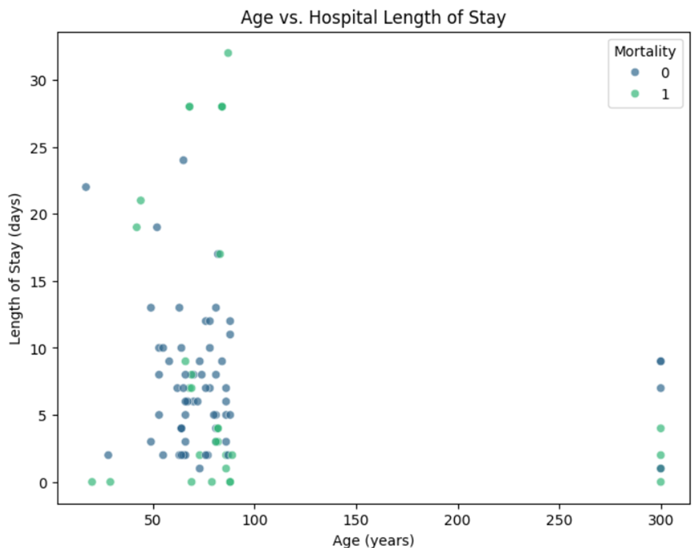
Age and Mortality: Older patients are slightly more likely to die, which is consistent with general medical trends.
Age and LOS: Older patients tend to have slightly shorter stays, possibly due to higher mortality rates or differences in treatment approaches.
LOS and Mortality: Longer stays are weakly associated with higher mortality, likely because patients with severe conditions require extended hospitalization.
The scatter plot illustrates the relationship between age and hospital length of stay (LOS), showing a weak negative trend where older patients tend to have slightly shorter stays. Non-survivors (mortality = 1) are somewhat concentrated among older patients and those with longer LOS, indicating weak positive correlations. However, the overall relationships are subtle, suggesting that age and LOS alone are not strong predictors of mortality.

Slide 14
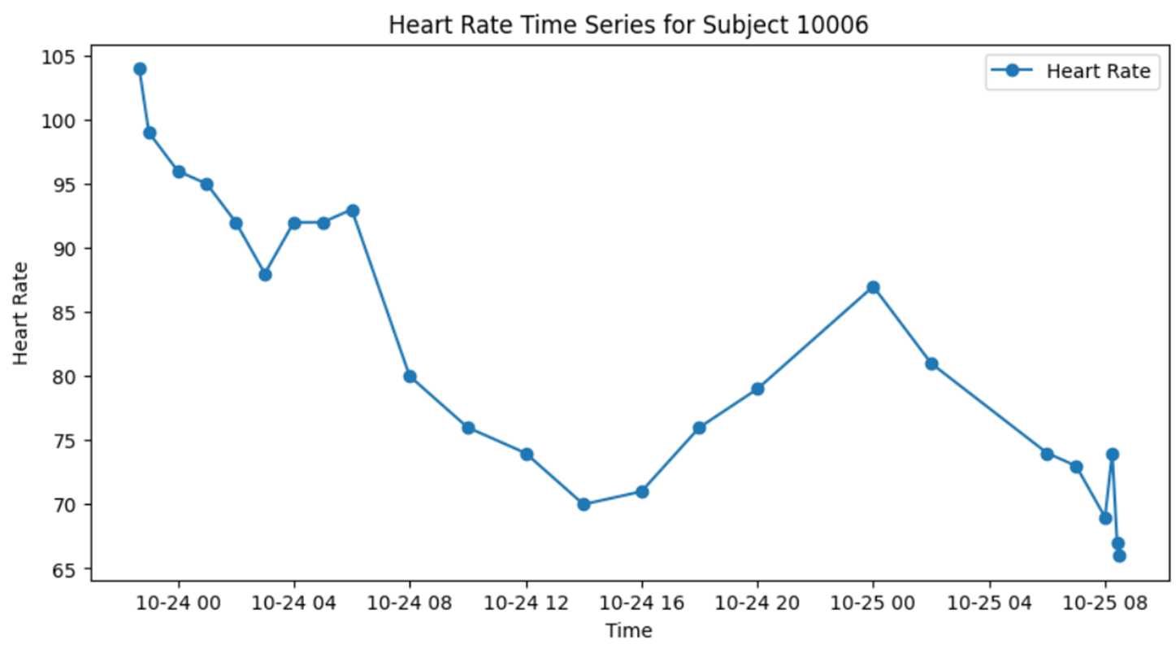
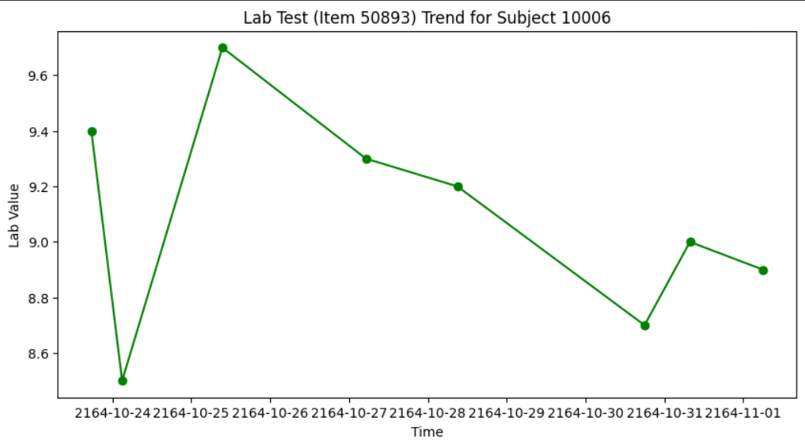
The statistical characteristics and correlations guide our feature engineering—such as computing average values, trends, and abnormality flags—which are essential for early deterioration prediction.

Slide 15
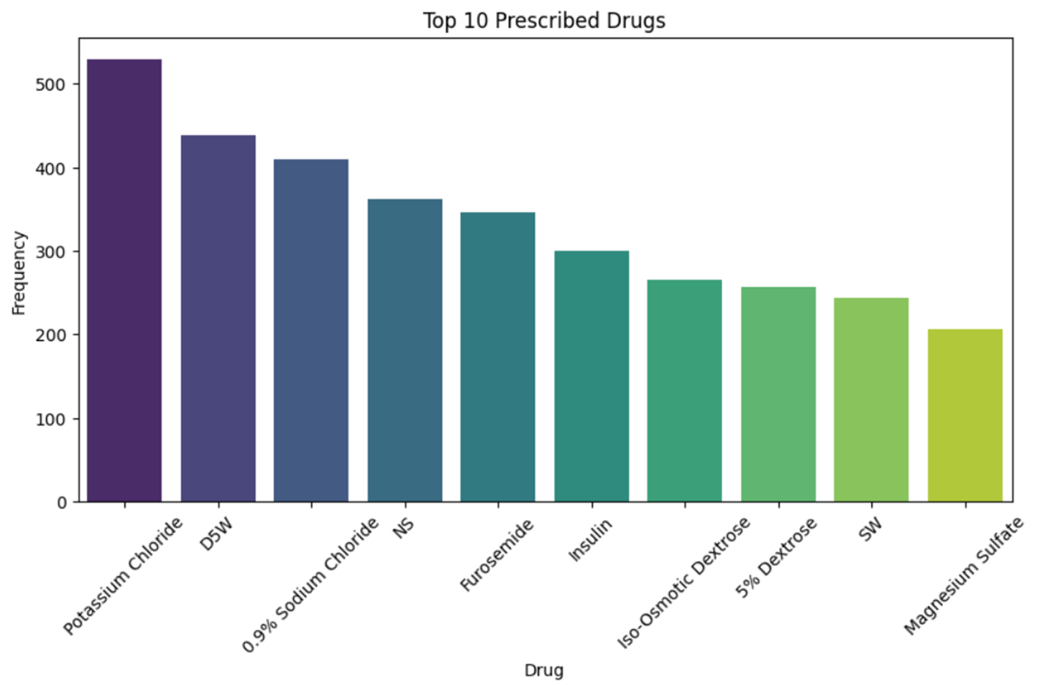
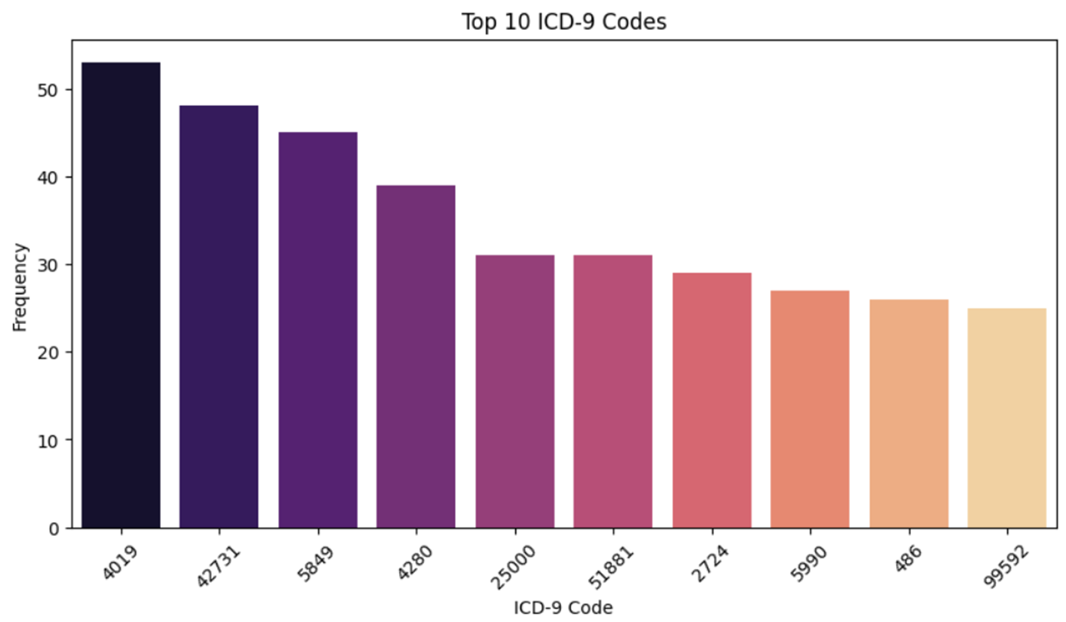
These insights allow us to incorporate medical history and comorbidity information into our risk models, improving patient risk stratification.

Slide 16
ALGORITHMS TO BE USED:
Prediction (Early Deterioration Prediction):
Logistic Regression
Random Forest
XGBoost
Objective: Predict if a patient will deteriorate early based on vital signs, lab results, and medical history.
Task Type: Supervised learning prediction (binary classification or time-to-event prediction).
Outcome Variable: A binary indicator (e.g., "deterioration: yes/no") or a risk score derived from patient outcomes.
Classification (Risk Stratification):
Decision Trees
Random Forest / XGBoost
k-NN
Objective: Classify patients into risk levels to prioritize critical cases.
Task Type: Supervised learning classification.

Slide 17
.
Number of Categories: 3 categories
Low Risk
Medium Risk
High Risk
Multimodal Data Integration: Combining structured (demographics, labs, vitals) and unstructured data (clinical notes) to build a holistic model.
NLP Techniques: Extracting insights from clinical notes using techniques such as word embeddings or transformer-based models to uncover hidden patterns and improve decision-naking.
TF-IDF + Logistic Regression / SVM
BERT / BioBERT
LDA
Time-Series Analysis: Analyzing time-series data from vital signs and lab results to detect trends and potential complications before they become critical.
LSTM
ARIMA
Explainable AI: Using methods like SHAP or LIME to interpret model predictions and support clinical decision-making.

Slide 18
REFERENCES
https://www.zhaw.ch/storage/engineering/institute-zentren/cai/studentische_arbeiten/Herbst_2023/1st_Master_Project_23_bogo_DataAnalysisMortalityPrediction.pdf
https://www.frontiersin.org/journals/public-health/articles/10.3389/fpubh.2021.818439/full
https://arxiv.org/abs/2009.01366?utm_source=chatgpt.com
https://physionet.org/content/mimiciv/2.2/
https://link.springer.com/article/10.1007/s41019-022-00176-6

Slide 19
THANKYOU

